Slide 1

Exploring Microsoft Azure
By: Ben Phillippy, Matt Chylack, Shane Artis

Slide 2

Project and Presentation Outline
Step 1: Completed AZURE Trainings
Step 2: Identified our Dataset and Key Azure Trainings to use for Project
Step 3: Discovered and Uploaded Data to Microsoft Data Explorer
Step 4: Created Visualizations to better understand dataset and trends
Overview

Slide 3
AZURE Trainings
Step 1: Completed AZURE Trainings
Between the three of us completed trainings within; Understanding Data Concepts, Designing effective Power BI reports, Fundamentals of Microsoft Dynamic 365 Supply Chain Management, Data visualization with Azure Data Explorer, Data analysis with Kusto Query Language, and Analyze monitoring data with Kusto Query Language
*Used Chat GPT for additional reference on KQL code
*Azure Trainings that were more applicable to our final project are bolded

Slide 4

Identified Our Dataset
Step 2: Identifying Dataset and AZURE Trainings Needed
Obtained data from U.S. Agency for International Development
This data provides supply chain health commodity shipment and pricing data from 2015
This data is valuable for understanding ranges and trends in pricing, spending, and volumes delivered by country for specific health commodities
Dataset has 33 Columns and 10335 rows

Slide 5
Taking What we Learned From AZURE Trainings
Step 2: Identifying Dataset and Azure Trainings Needed
Learning path: Data Analysis with Kusto Query Language
Taught us the fundamentals of query language and use of aggregate functions
count, dcount, countif, sum, min, max, avg, percentiles, and others
Learning path: Data visualization with Azure Data Explorer
Taught us how make different graphs and charts

Slide 6
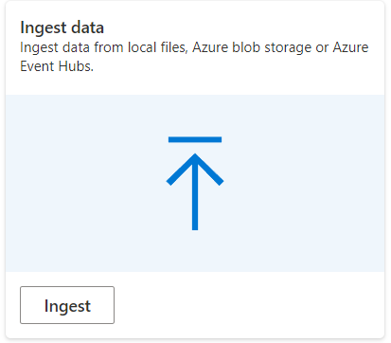
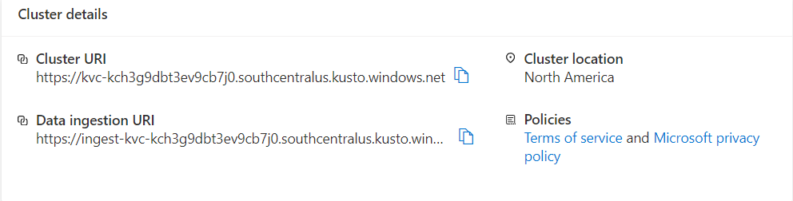
Uploading Our Data
Step 3: Discovering and Uploading Using Microsoft Data Explorer
Uploaded data directly into Data Explorer
We discovered that we could upload our data without the use a hot blob or VM
We ingested our data set as a CSV file from our downloads
Created a cluster
Used cluster URI path to create a KQL database

Slide 7
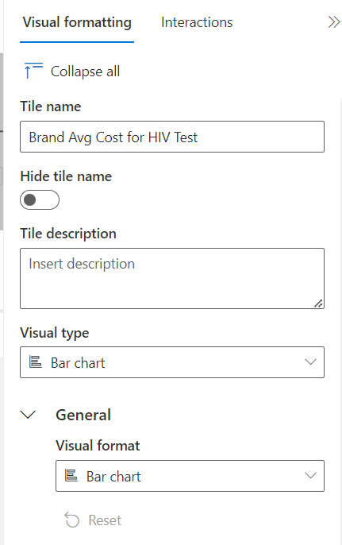
Creating Visualisations within Data Explorer
Step 4: Creating Visualizations
After uploading the data we were able to begin coding
Using KQL we were able to narrow our data down into several queries to create different visualizations
Works by querying, logs, events, traces, and time series data
Uses advanced data statistics for efficient query planning and just-in-time compiled query execution
After completing our first query to generate a result we selected a visualization type and format
We used the interface to input the titles and adjust the X and Y scales
Data Explorer Interface

Slide 8
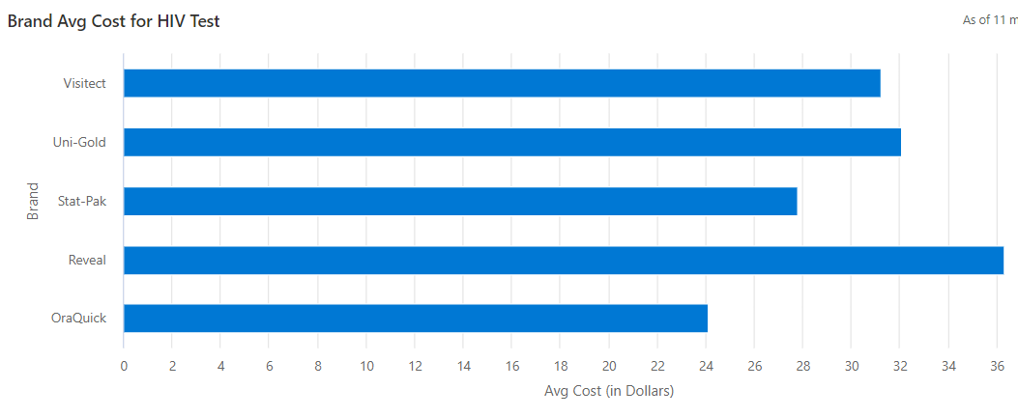
Our First Visualisation
Step 4: Creating Visualizations
Displays Top 5 Brands Avg Cost for HIV test kits.
From here we created a dashboard where we would combine all of our future visualizations on one page.

Slide 9
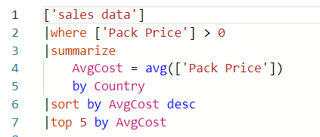
Vis 2: Top 5 Countries AVG Cost for HIV/AIDS Health Care
Step 4: Creating Visualizations

Slide 10
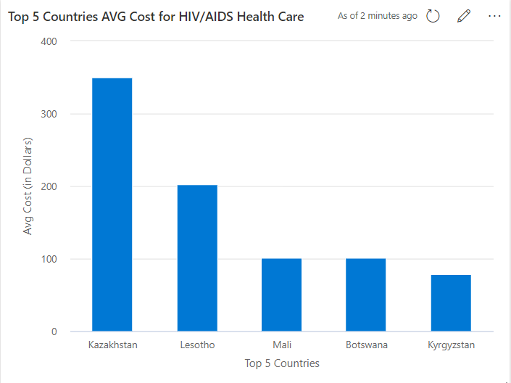
Vis 2: Result
Step 4: Creating Visualizations

Slide 11

Vis 3: Number of Shipments Per Country
Step 4: Creating Visualizations

Slide 12
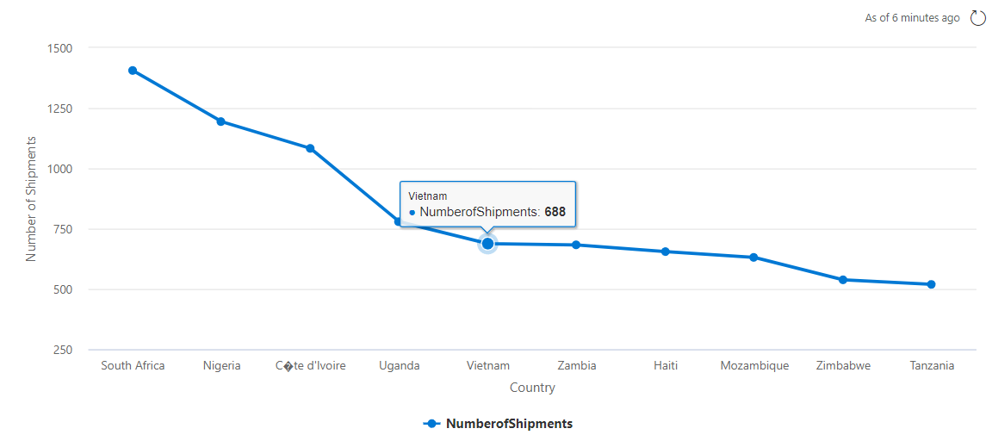
Vis 3: Result
Step 4: Creating Visualizations

Slide 13
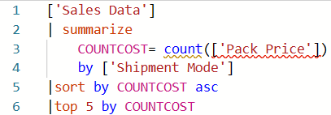
Vis 4: Percentage Modes of Shipment
Step 4: Creating Visualizations

Slide 14
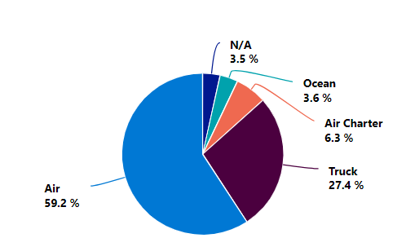
Vis 4: Result
Step 4: Creating Visualizations
As you can see Air travel made up more than half of the total shipment methods, followed by trucking with slightly over a quarter.

Slide 15
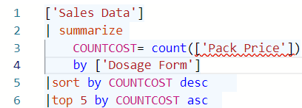
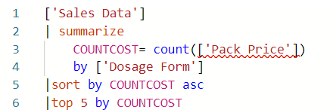
Vis 5: 5 Most Expensive and least Expensive Dosages By Package Prices
Step 4: Creating Visualizations
Top 5 Code
Bottom 5 Code

Slide 16
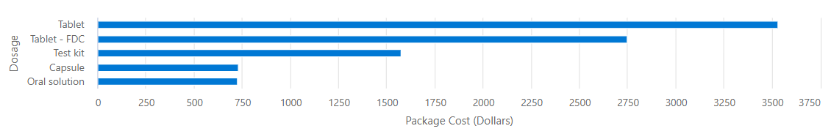
Vis 5: Most Expensive Results
Tablet dosage form is the most expensive package
Step 4: Creating Visualizations

Slide 17
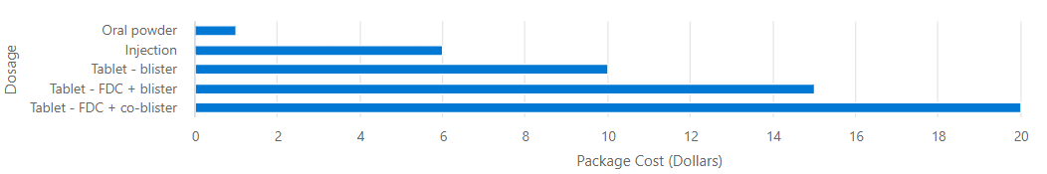
Vis 5: Least Expensive Results
Oral powder dosage forms ranks as the least expensive
Step 4: Creating Visualizations

Slide 18
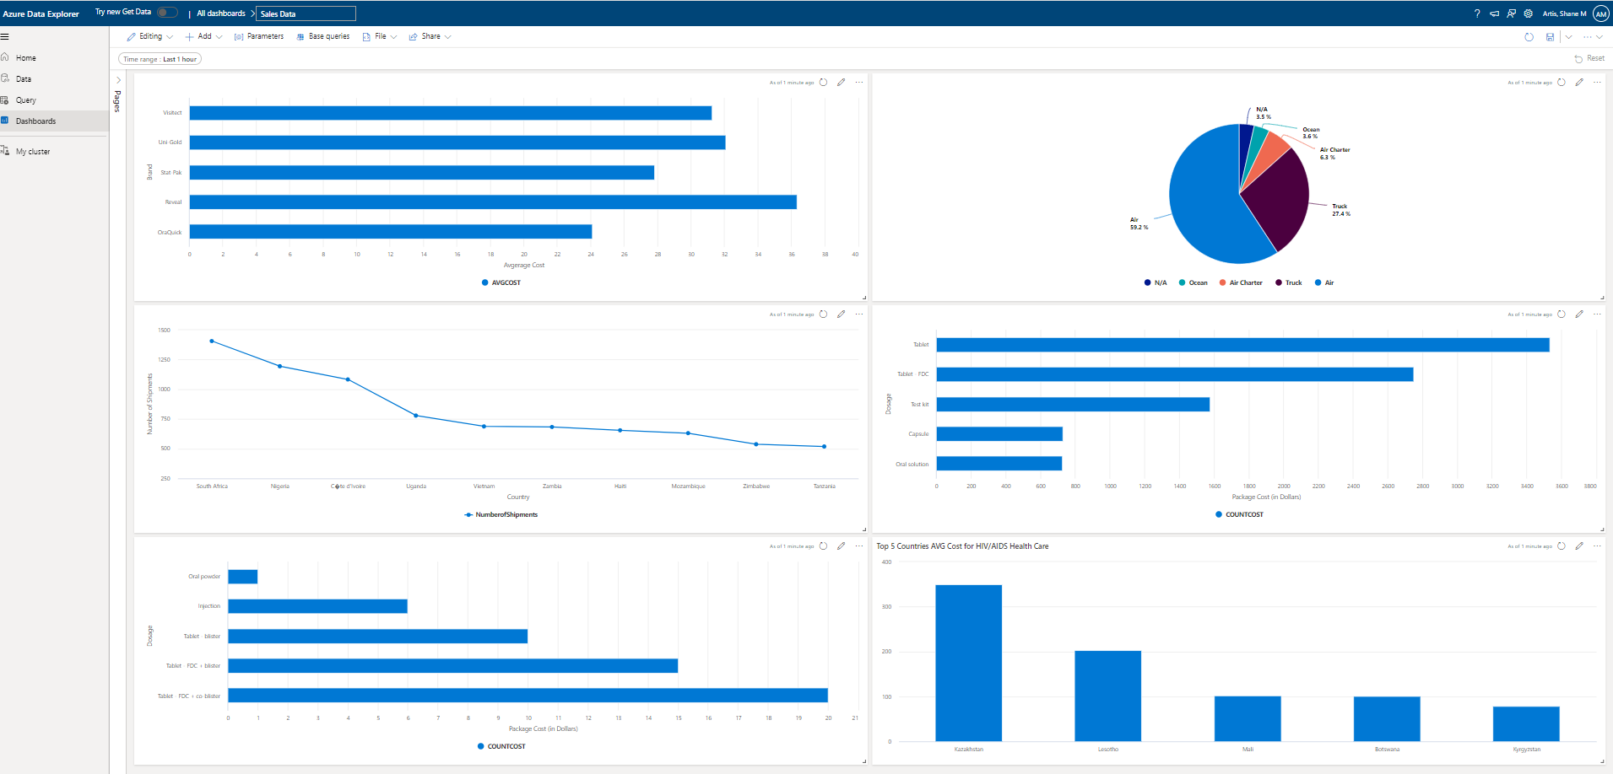
Final Dashboard

Slide 19
Overview
Azure Trainings guided us towards learning and using KQL and creating visualizations using it
Discovered Microsoft Data Explorer as a way of uploading data without VM or hot blob
Were able to begin performing our KQL code from right within Data Explorer
Visualizations created:
Found the most expensive brands of HIV/Aids test kits
Determined the countries with the highest cost for HIV/AIDS healthcare
Found the 10 countries that had the greatest number of test kits shipped to them
Found the percentage each form of transportation was used for shipping test kits
Located the 5 least expensive and 5 most expensive forms of dosage treatment
Final Result of the Dashboard displayed

